Slide 1

Paperless Data Collection
LAS 6292:
Data Collection & Management
Emilio M. Bruna
University of Florida

Slide 2
Remember…
Efficient
Data Collection
means…

Slide 3

...you will save
time & money.

Slide 4


Saving time & money means…
…Less stress.

Slide 5


So…
how can we be more
efficient?

Slide 6
Option 1:

Slide 7

Travel more quickly between field sites by hiring a rally car driver.
This is a bad idea.
Please don’t do this.
Don’t.
I mean it.

Slide 8
Option 2:

Slide 9

Avoid errors.

Slide 10
Remember:

Slide 11
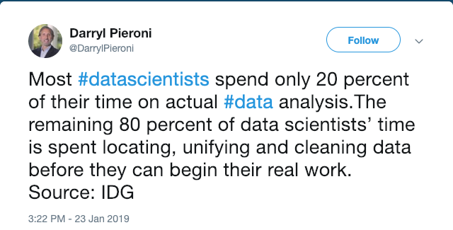

Slide 12
Where do errors enter the dataset?
Data (Re)organization
Project
Planning
Data Collection
Data
Entry
Data
Correction
Data Organizing for Analysis
Data Analysis
More Data Correction

Slide 13

Here.
Data (Re)organization
Project
Planning
Data Collection
Data
Entry
Data
Correction
Data Organizing for Analysis
Data Analysis
More Data Correction

Slide 14
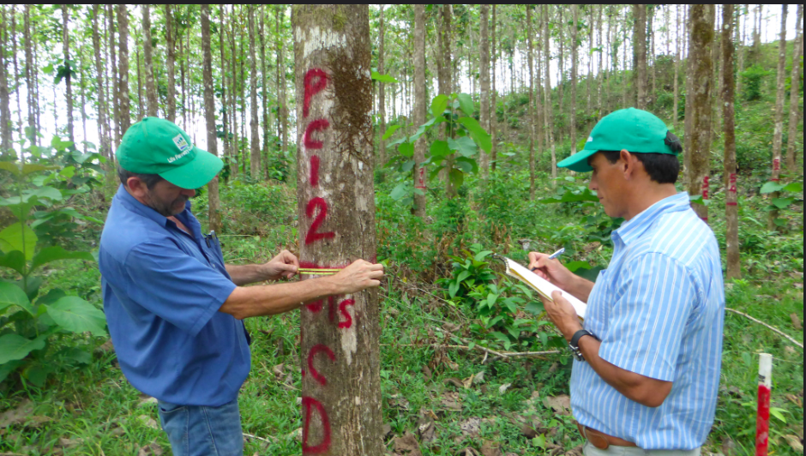
During Data Collection…
Measuring incorrectly,
Misreading labels,
Writing down incorrect values,
Incomplete data collection…

Slide 15

And especially during data transfer.
i.e., when transferring information from data sheets or notebooks to spreadsheets or other electronic formats

Slide 16
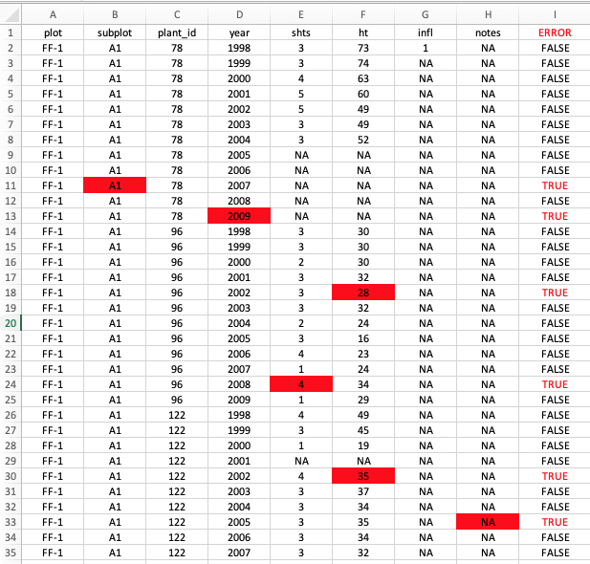
What if I told you that we could make Data Transfer Errors…vanish?
vanish?

Slide 17
How?!

Slide 18
Paperless
Electronic
Efficient
Data Collection
(as in…no more paper)

Slide 19

You can’t be serious.
(yes, I am.)

Slide 20




Instead of:
Let’s try:
analyze
upload
(right away)
write
(in the field)
type
(in the field)
type
(days or weeks later)
upload

Slide 21

Say hello to your new field notebook.

Slide 22


Slide 23
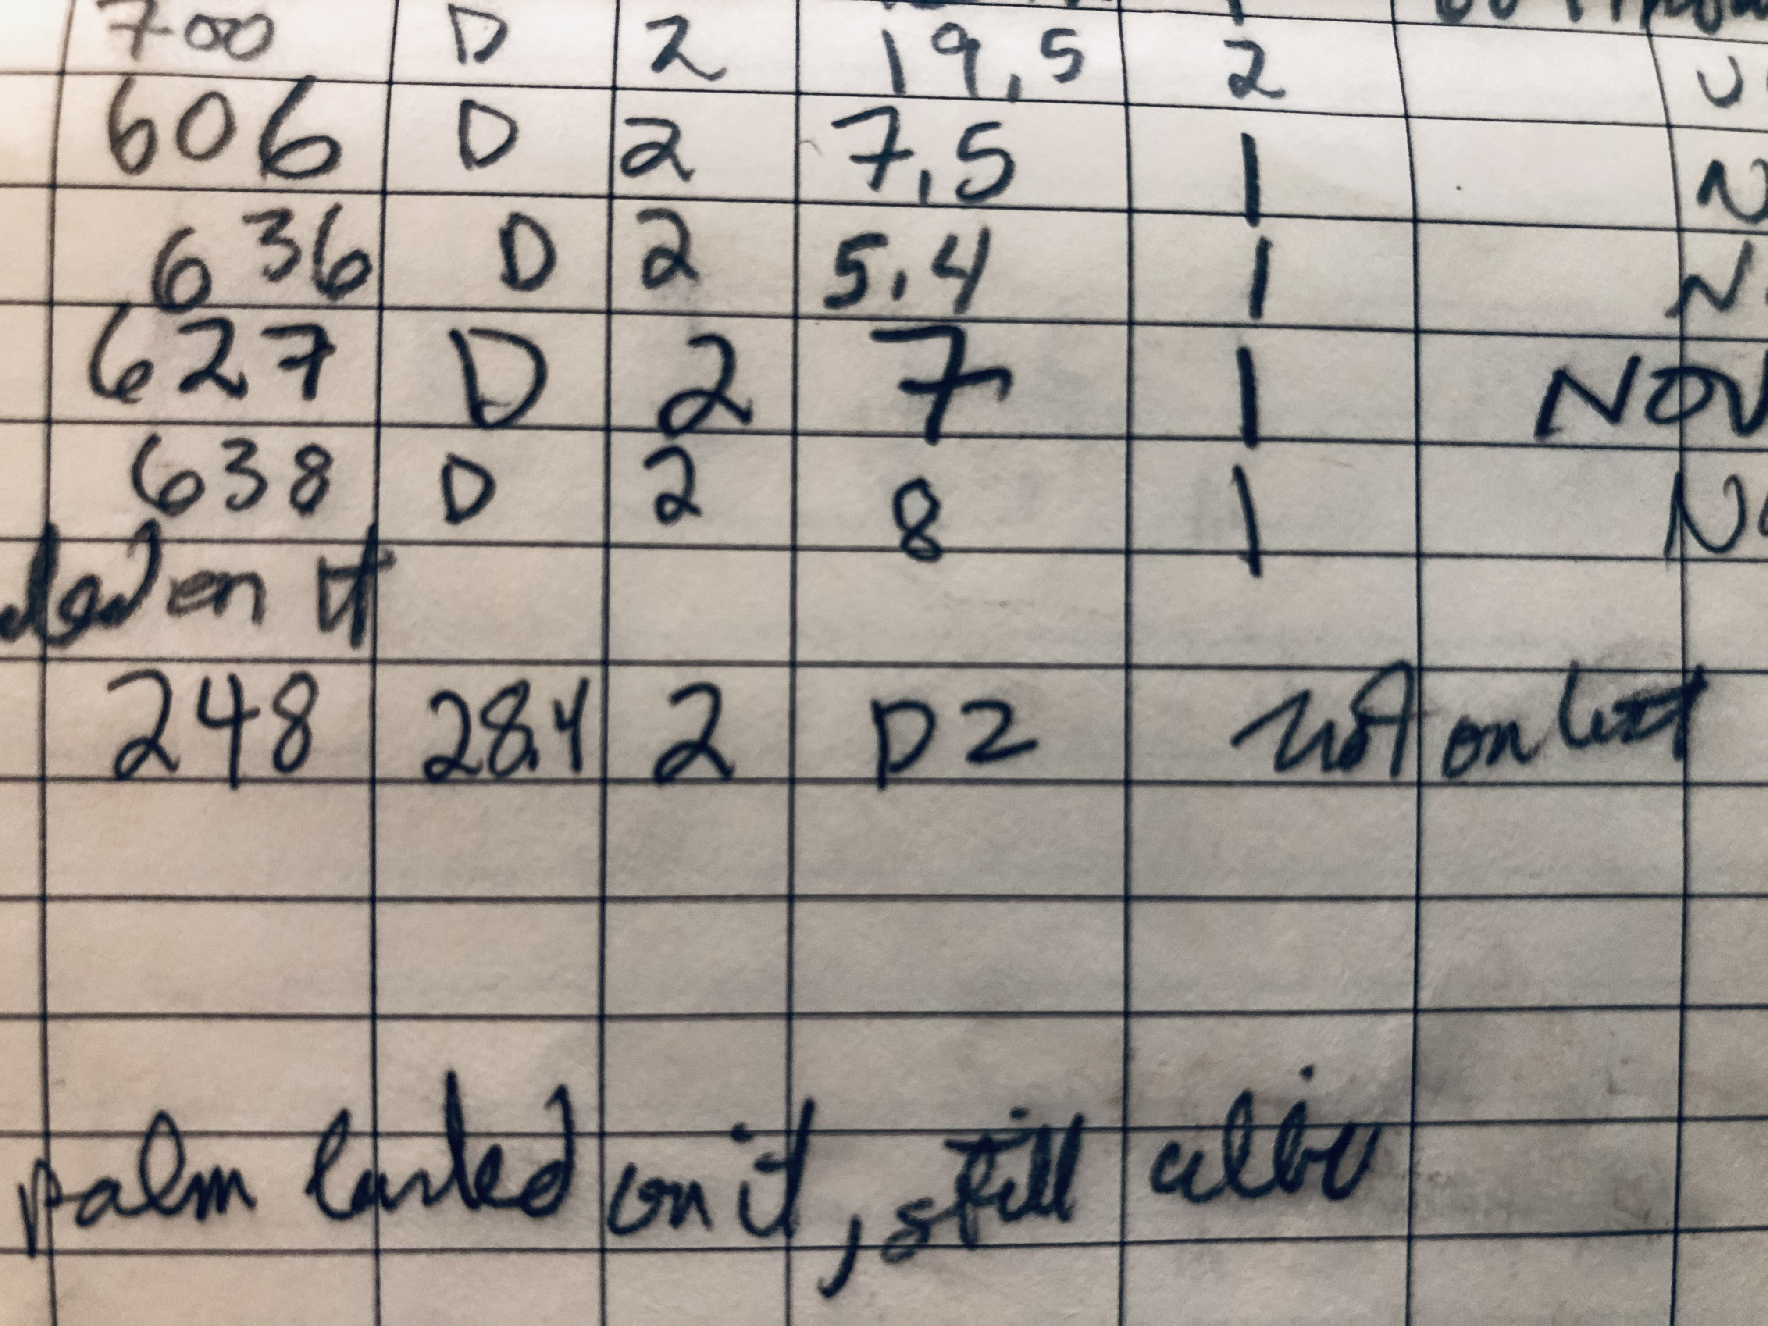
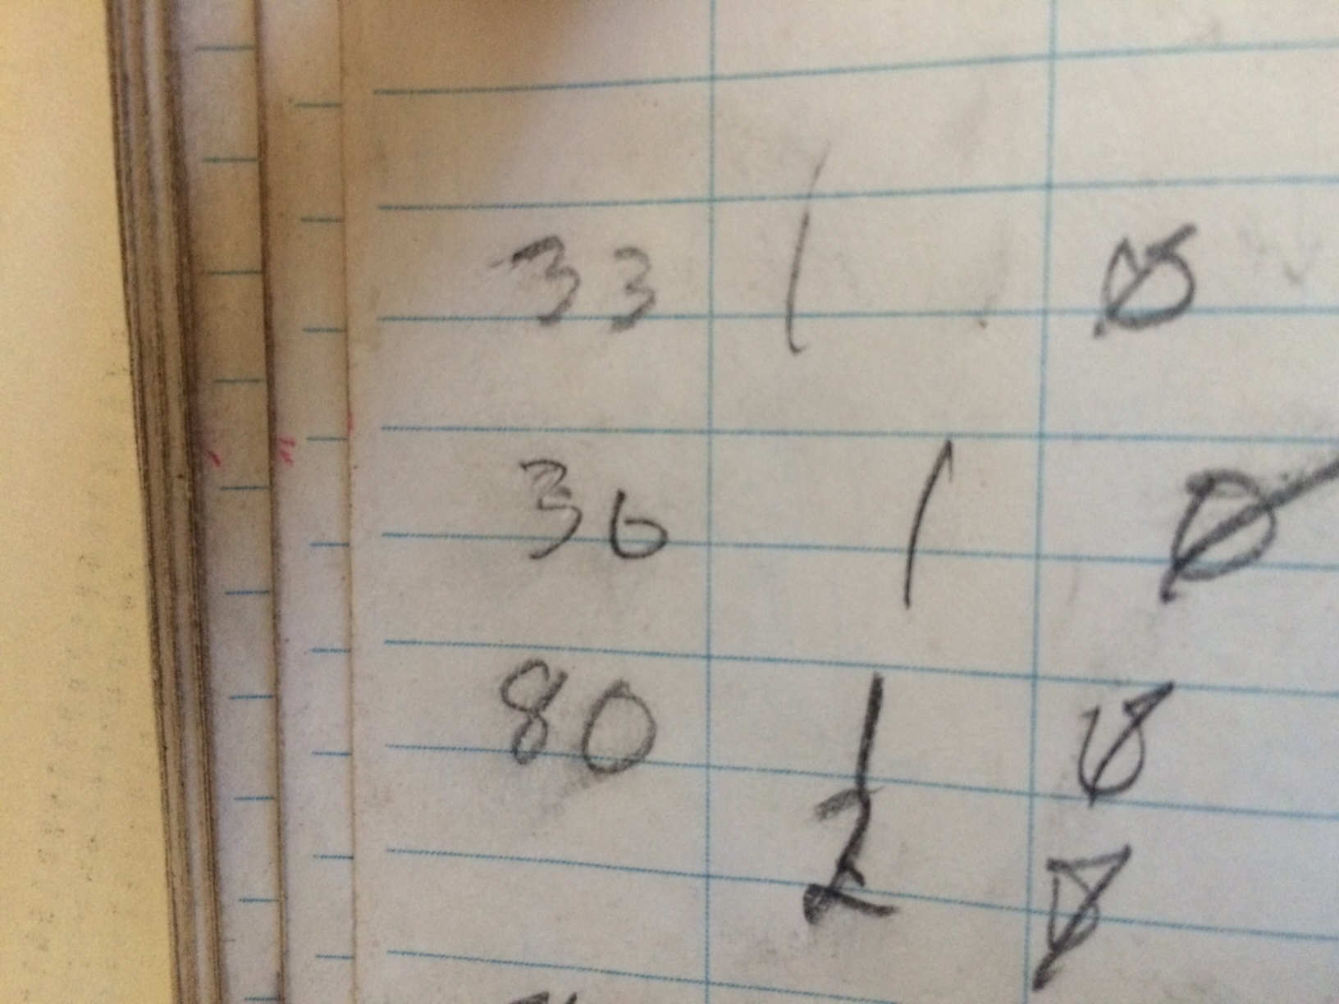
Benefits of Paperless Data Collection
(1) increases data quality & reduces errors
1. Limit data entry to valid values
2. Can help ensure all required data are collected
3. Eliminates typing mistakes and errors due to guesses
Zero or Six?
huh?
“Not on list”
“palm landed on it, still alive.”

Slide 24

Benefits of Paperless Data Collection
(2) Reduces Risk of Data Loss
“Look what I found…
I wonder who it belongs to?”

Slide 25
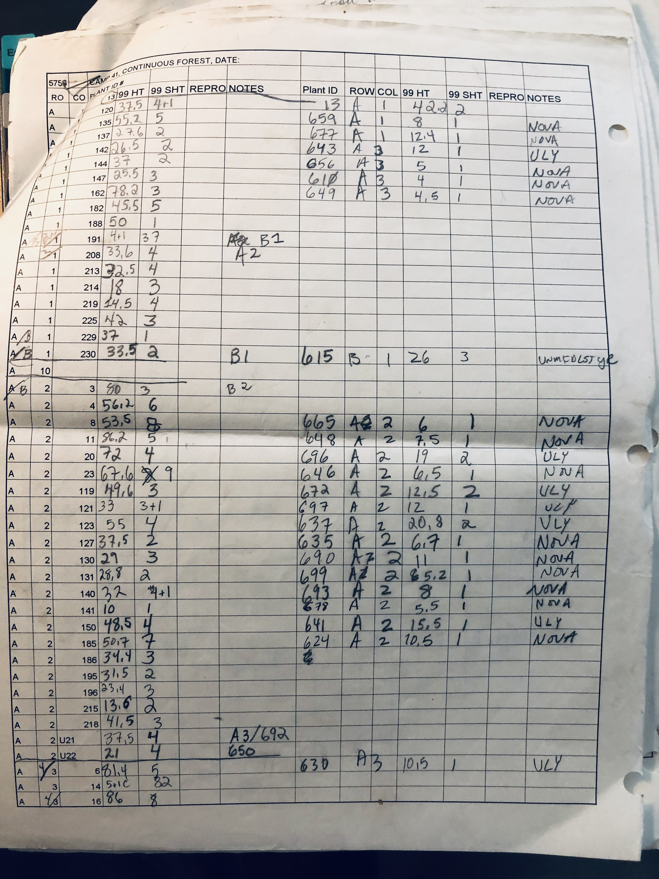
Benefits of Paperless Data Collection
(3) Time Saved
Example: Survey Data
This Data Sheet:
Data: 337 unique pieces of information written down
(44 x 4) + (7 x 23)=337
2. Each Data Point: 1-4 characters
(numbers, decimals, letters)
3. Estimated No. of keystrokes: 500

Slide 26
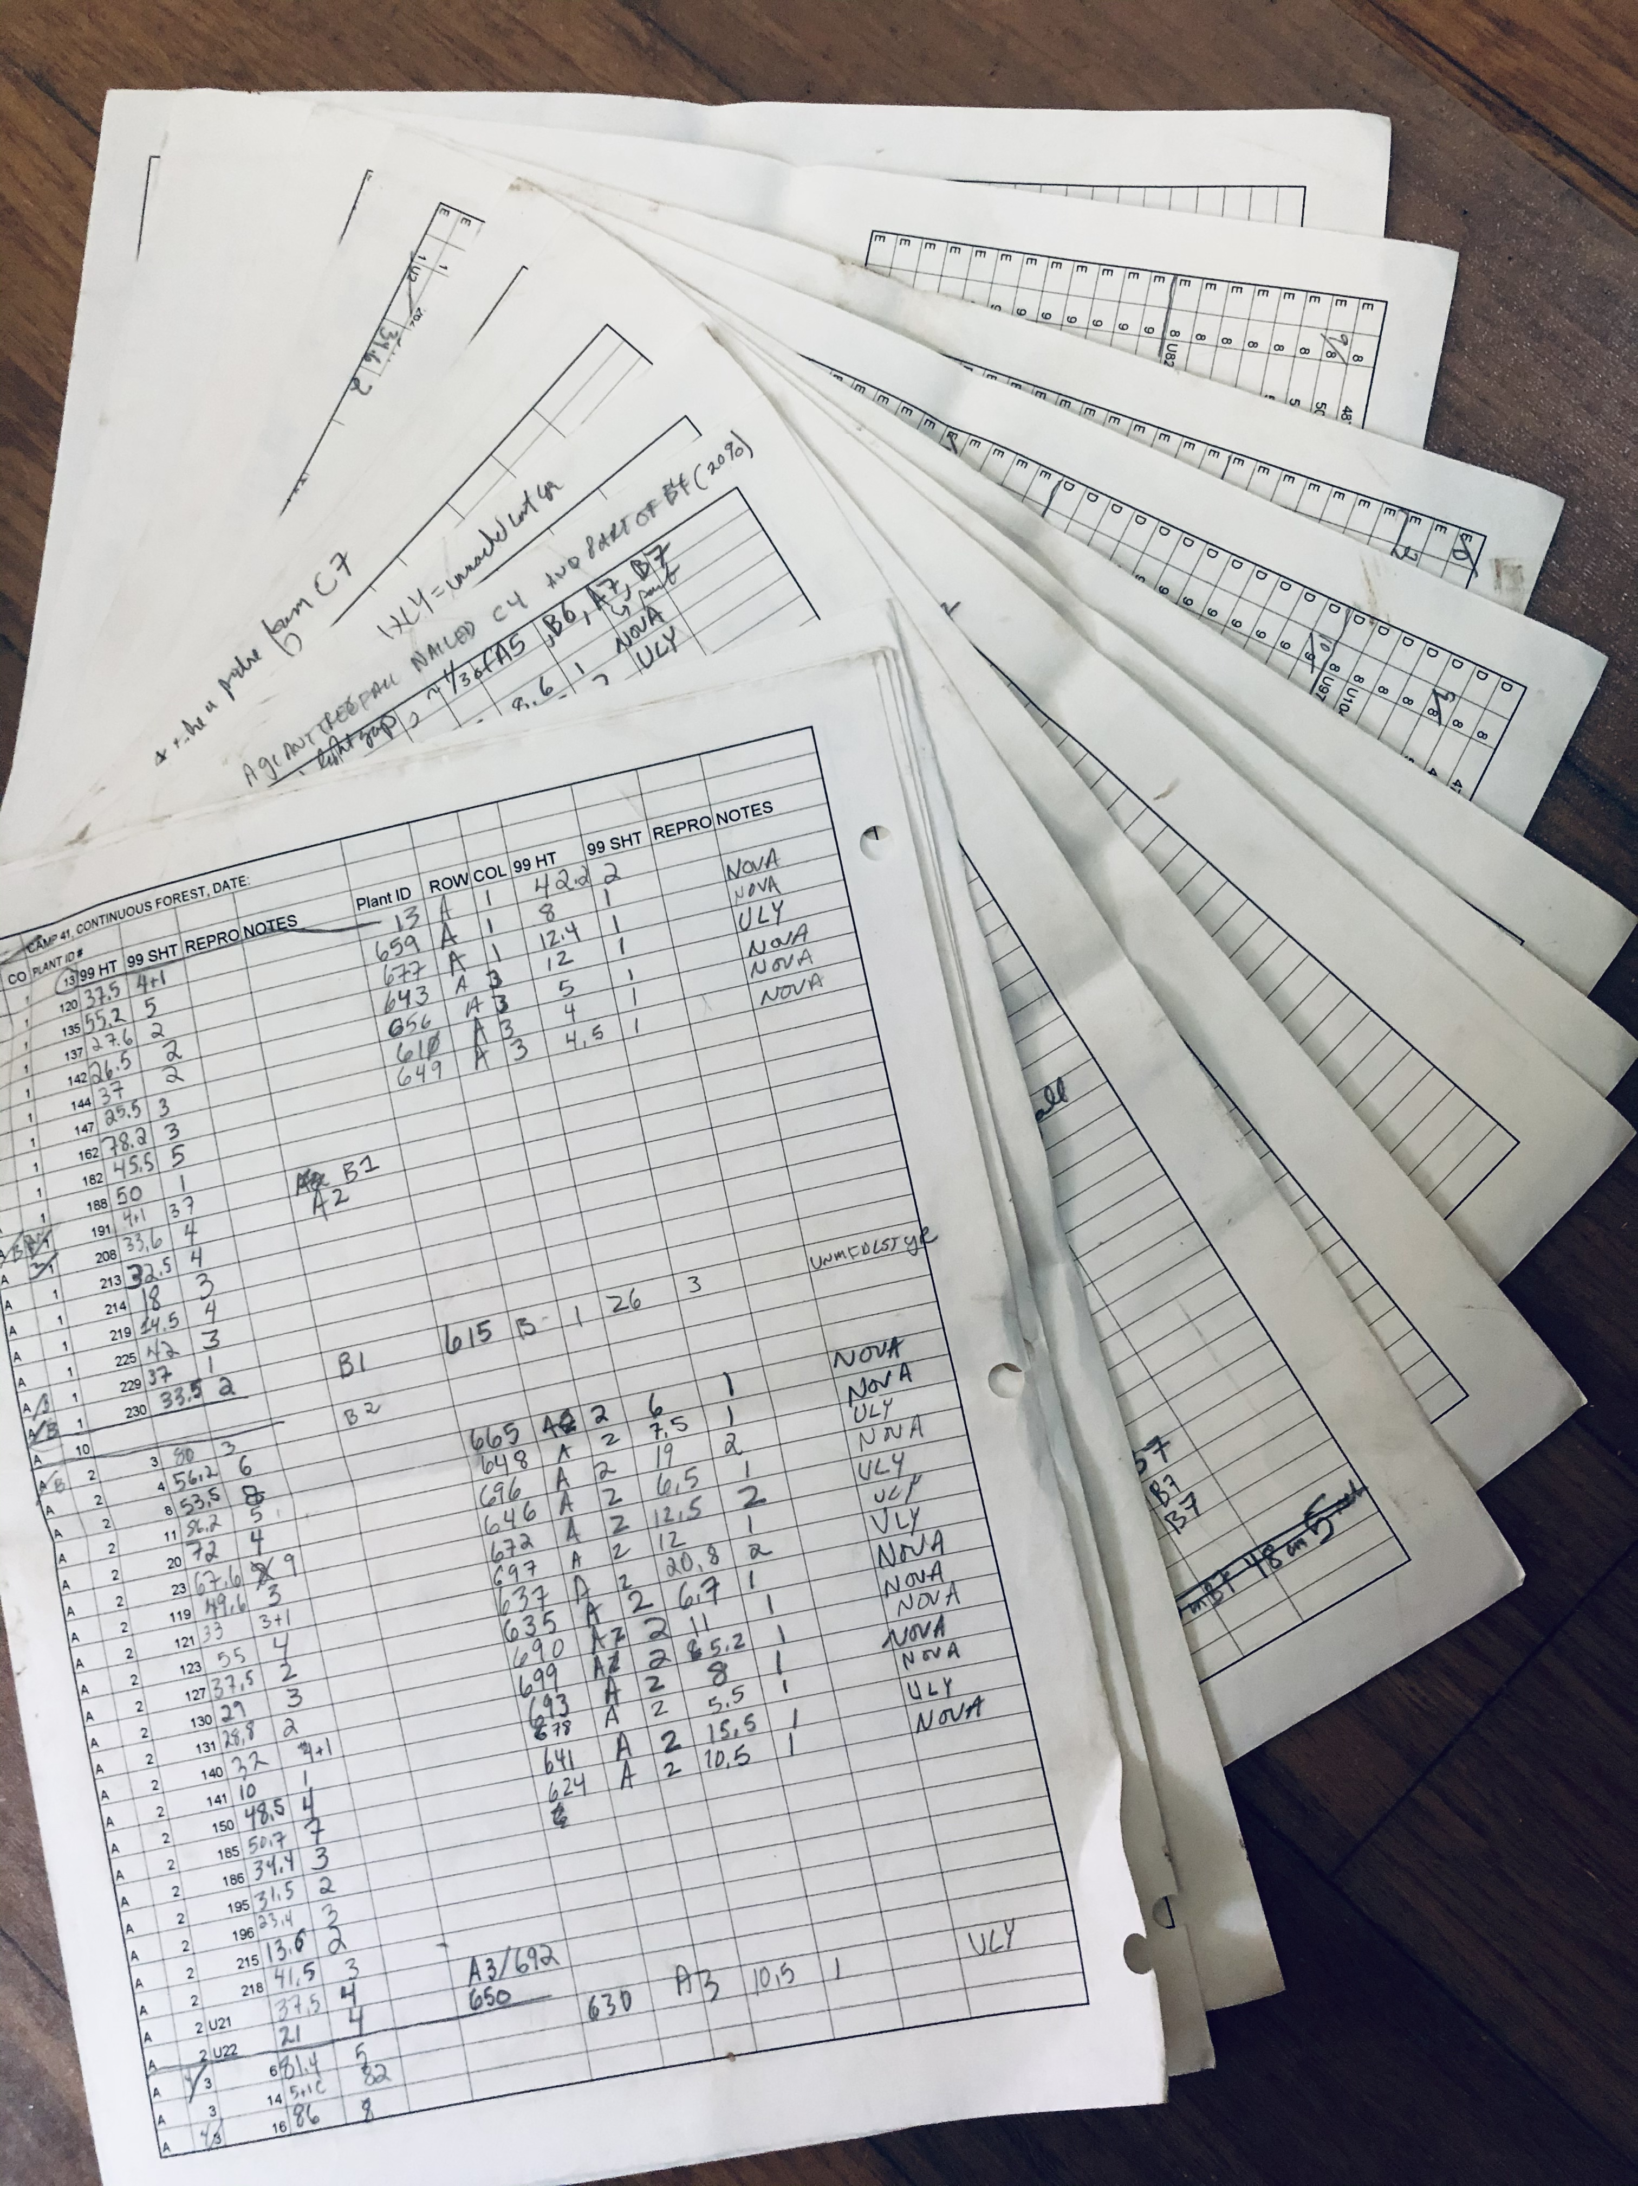
Benefits of Paperless Data Collection
(3) Time Saved
This Location:
12 sheets (some with up to 500 pieces of data recorded)

Slide 27
Benefits of Paperless Data Collection
(3) Time Saved
This Study
13 locations surveyed
per year

Slide 28
Benefits of Paperless Data Collection
(3) Time Saved
Study Duration
10 years

Slide 29
~ 800,000
keystrokes
to enter the data
~ 800,000
opportunities to make a mistake when entering the data

Slide 30
Are there any shortcomings?
Screen size limits the ability to see multiple questions or quickly go back and forth
Gathering data may take longer (though still far less than data entering & cleaning)
Takes practice, pretesting, and more effort to set up forms
Battery life & availability of power sources
Backing up when there is no, slow, or unreliable internet or cell service
Cost

Slide 31

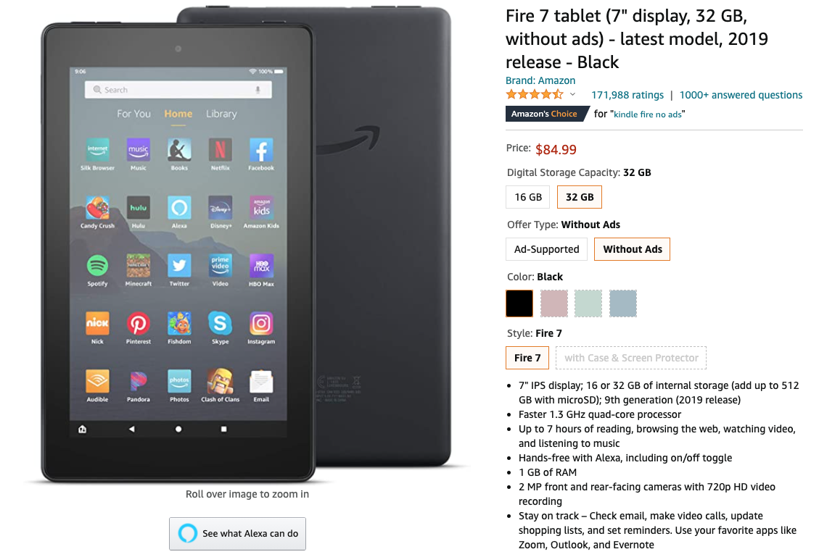
But note: used ones are readily available at reasonable prices.

Slide 32
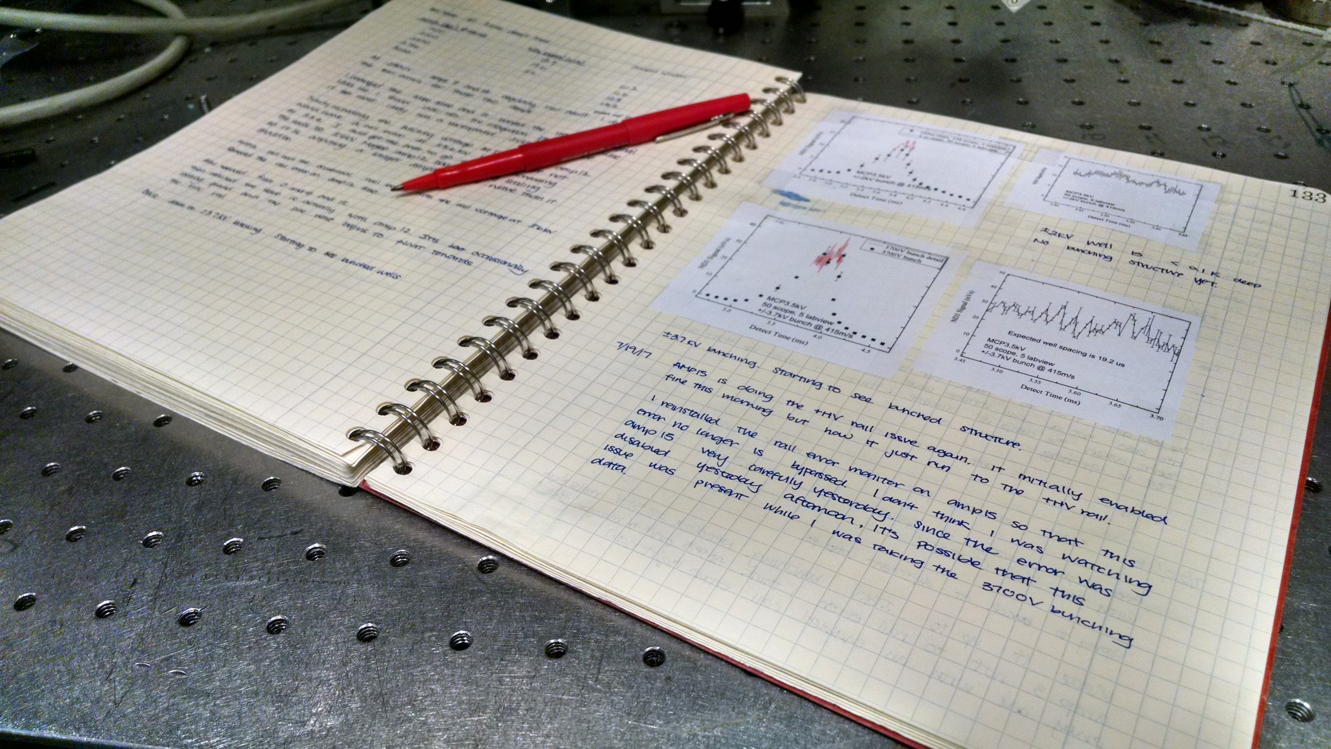
But I don’t work in the field…
I do lab / office / computer-based research!
Photo: https://jila.colorado.edu/lewandowski/research/scientific-communication-notebook-documentation

Slide 33
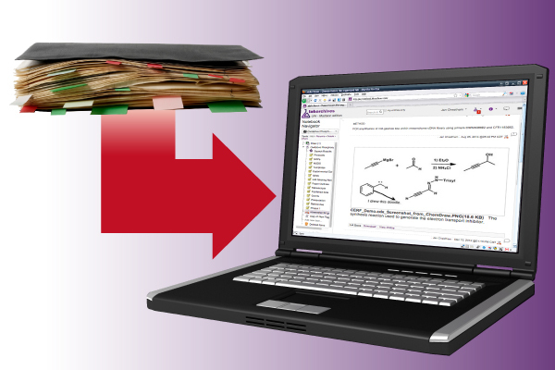
We’ve got you covered:
ELN: Electronic Lab Notebooks
Photo illustration: Troy Slama/DoIT (link to original)

Slide 34
Music: ‘Going Higher’ by Bensound
www.bensound.com

Slide 36

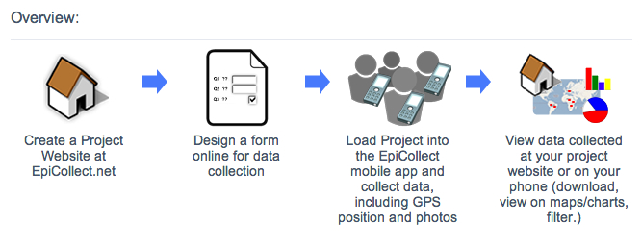

Slide 37
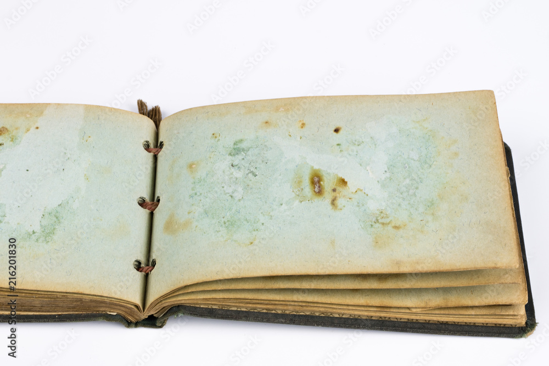

Slide 43



Planning carefully
Make the most of your limited time.
Using checklists
Have everything you need when you need it.
Working Efficiently
Collect only the data you need with well-designed forms

Slide 44
1. By going faster
Data (Re)organization
Project
Planning
Data Collection
Data
Entry
Data
Correction
Data Organizing for Analysis
Data Analysis
More Data Correction

Slide 45
For example, to speed-up your
Data (Re)organization
Project
Planning
Data Collection
Data
Entry
Data
Correction
Data Organizing for Analysis
Data Analysis
More Data Correction

Slide 46
For example, to speed-up your Data Collection…
Data (Re)organization
Project
Planning
Data Collection
Data
Entry
Data
Correction
Data Organizing for Analysis
Data Analysis
More Data Correction
you could…

Slide 47
Instead,
you could spend less time collecting data by…

Slide 48
1. By doing things
Data (Re)organization
Project
Planning
Data Collection
Data
Entry
Data
Correction
Data Organizing for Analysis
Data Analysis
More Data Correction

Slide 49
Another way to become more efficient is to:

Slide 51
Data (Re)organization
Project
Planning
Data Collection
Data
Entry
Data
Correction
Data Organizing for Analysis
Data Analysis
More Data Correction

Slide 53
2. Not
Data (Re)organization
Project
Planning
Data Collection
Data
Entry
Data
Correction
Data Organizing for Analysis
Data Analysis
More Data Correction

Slide 54
2. Spend less time and money) finding & correcting mistakes

Slide 55
Where are most errors introduced?

